Slide 1
SUMMER TRAINING PROJECT ON MACHINE LEARNING
----PRESENTED BY SAURABH SHARMA (158)

Slide 2




Slide 3







•
•
•
pip install nltk
•
•
nltk.download()

Slide 4
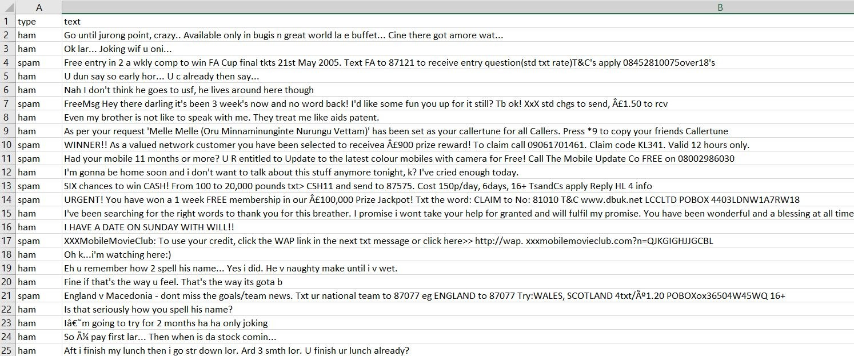

Slide 5





Slide 6








•
▪
▪

Slide 7
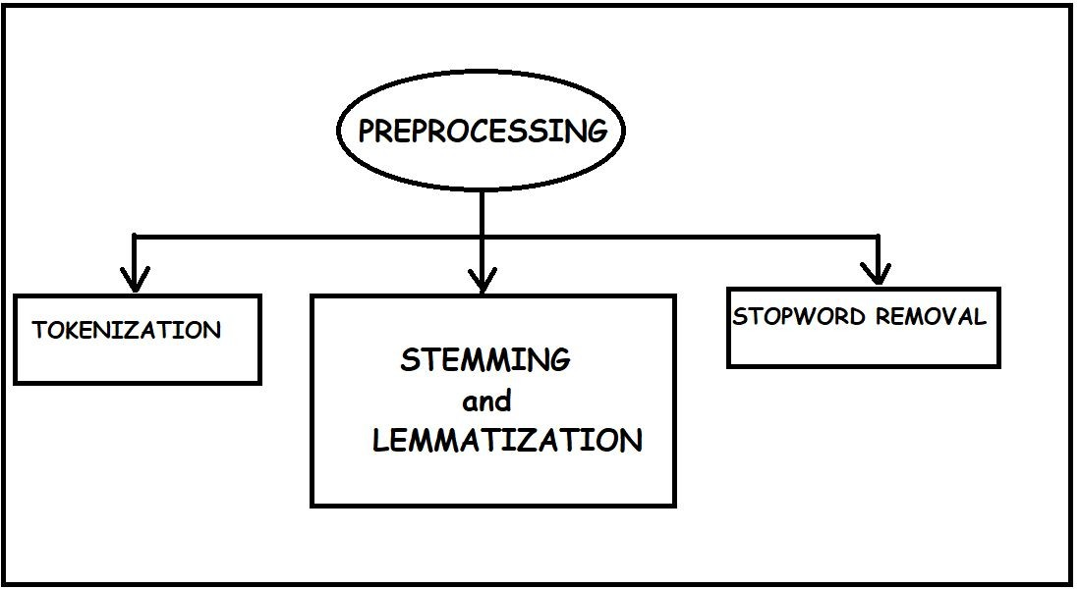

Slide 8




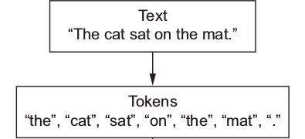
•

Slide 9


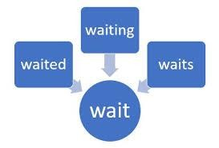



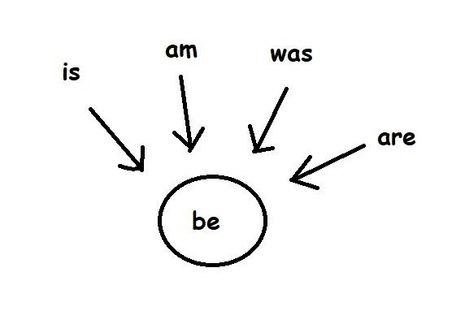
•
Lemmatization is the algorithmic process of finding the lemma of a word depending on their meaning. Lemmatization aims to remove inflectional endings. It helps in returning the base or dictionary form of a word, which is known as the lemma. The major difference between stemming and lemmatizing is stemming can often create non-existent words, whereas lemmas are actual words.
•

Slide 10
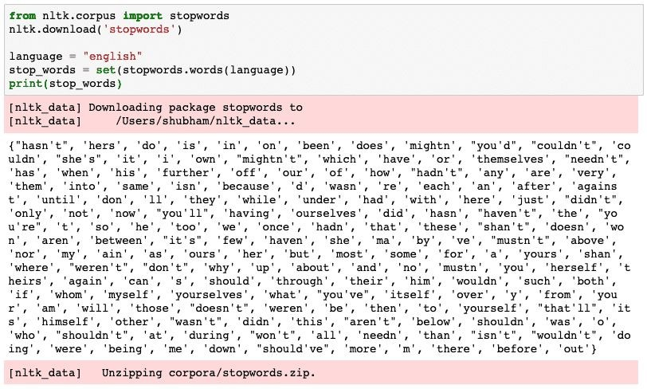

•

Slide 11






Slide 12

IDF(t) = log_e(Total number of documents / Number of documents with term t in it)
•
•
WI,J=weight which signifies how important a word is for individual text message
TF I,J =(no. of times I occurred)/(total no. of terms
in J)
•

Slide 13


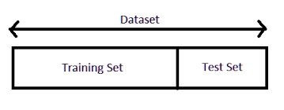
train_test_split from sklearn.model_selection
>>> from sklearn.model_selection import train_test_split
X_train, X_test, y_train, y_test = train_test_split(X, y, test_size = 0.3, random_state =0)

Slide 14
The Classification algorithm is a Supervised Learning technique that is used to identify the category of new observations on the basis of training data. In Classification, a program learns from the given dataset or observations and then classifies new observation into a number of classes or groups. Such as, Yes or No, 0 or 1, Spam or Not Spam, cat or dog, etc. Classes can be called as targets/labels or categories.
•
•
sklearn.linear_model

Slide 15
•

Slide 16
THANK YOU

